Slide 1
Risk Classification and Loan Modeling Solution Accelerator
Financial Services and Insurance industries
Notes:
Thanks for your time today. I’m excited to talk with you about how the Risk Classification and Loan Modeling Solution Accelerator. This solution can help you quickly and efficiently predict the amount of loan that will be approved by the Small Business Administration. That in turn helps you process your loans faster, enabling you to process accurate, SBA-compliant loan amounts in less time.

Slide 2

Small business loan applications are at an all-time high
COVID-19 and recovery increased loan supply and demand, intensifying pressure on lenders
The Small Business Administration’s (SBA) traditional 7a, 504, and microloan programs collectively reached a record high loan volume in Fiscal Year 2021.¹
.96% drop in interest rates between 2020 and 2021 spurred a surge in loan applications.²
41% growth in the SBA’s 504 flexible, low-interest loan program in FY21.¹
30% increase in applications to start small businesses in FY21, compared to before the pandemic.³
$450 million delivered by the American Rescue Plan to over 6 million small businesses and nonprofits in FY21.⁴
"SBA Administrator Guzman Announces $44.8 Billion Through Signature Lending Programs," U.S. SBA, Oct. 29, 2021.
"2022 SBA Loan Trends," Guidant, Nov. 30, 2021. (guidantfinancial.com)
"Fact Sheet: The New Small Business Boom Under the Biden-Harris Administration," The White House, Jan. 25, 2022.
"One Year Later: Biden-Harris Administration, SBA Have Prioritized an Equitable Recovery, Centered on Strengthening Main Street and Supply Chains," U.S. SBA, Jan. 20, 2022.
Notes:
Market Trends
More businesses are applying for Small Business Administration (SBA) loans than ever before.
FY21 was a record-breaking year for SBA’s traditional loan programs.
Between 2020 and 2021, interest rates dropped by nearly 1%, contributing to the surge in SBA loan applications. Additionally, interest rates are expected to rise in 2022, creating a sense of urgency for small businesses to apply before rates go up.
FY21 was also a record-braking year for small business growth, as there was a 30% increase in applications to create small businesses than before the pandemic.
The increased supply and demand for SBA loans is putting extra pressure on its lending partners to process loan applications and issue decisions in a timely manner.

Slide 3
Lenders struggle to keep pace with application volume
Inefficient processes create delays, limit informed decision making, and can increase risk
Reliance on labor-intensive, manual, and low-tech loan application processing creates backlogs and errors.
High volumes of loan applications lead to further bottlenecks and delays.
Delayed loan distribution can cause applicants to lose critical business opportunities and impact their risk profiles.
Inability to regularly run and re-run risk classification limits the accuracy of assessments.
Lack of efficient, precise loan modeling makes it difficult to determine exactly what the SBA will approve.
Notes:
Customer challenges
It can often be challenging for SBA-approved lenders to meet the needs of this exciting time for American small business growth, resulting in application backlogs and delays.
Low-tech loan application processing are inefficient and prone to human error
Delays can cause applicants to miss out on critical business opportunities, which can affect loan applicants’ risk profiles.
The inability to regularly run and re-run risk assessments not only limit accuracy of assessments, but can also leave lenders vulnerable to unaccounted-for changes in borrowers’ risk profiles
Lack of quick and precise modeling makes it difficult to predict what the SBA will approve

Slide 4

Automate loan application processing and SBA compliance
Increase efficiency and gain data-driven insights for faster, more informed loan decisions
Create a structured, automated methodology for ensuring SBA compliance.
Ensure timely delivery of approved loans to minimize risk.
Reduce defaults by loaning the right amounts with the right terms.
Improve the borrower experience and help protect customer supply chains.
Notes:
Desired business outcomes
SBA-affiliated lenders want to process their incoming loan applications quickly, efficiently, and aligned to SBA terms and regulations. They want to replace time-consuming legacy processes with predictive modeling that will take the tedium and guesswork out of their approval or rejection processes.
That will let them eliminate backlogs, get the right amount of money to the right applicants, and ensure SBA compliance all the way through the process.

Slide 5

Enable smarter and faster decisions for small business loans
Leverage machine learning and predictive modeling to process, analyze, and rule on SBA loans
The Risk Classification and Loan Modeling Solution Accelerator uses big data analytics and predictive modeling to quickly make increasingly accurate lending decisions in compliance with SBA guidelines, delivering the right loan amount to the right borrowers at the right time.
Get built-in compliance with SBA guidelines to determine optimal loan size.
Process applications faster to reduce backlog and deliver funds quickly.
Get more complete and timely loan repayments by right-sizing loans.
Easily launch the solution using pre-configured IP from Microsoft.
Notes:
Microsoft solution: overview
The Risk Classification and Loan Modeling Solution Accelerator enables you to quickly process and assess loan applications in accordance with SBA guidelines to determine the optimal loan size that the SB will approve for a given applicant
It leverages Azure Synapse Analytics and Azure Machine Learning to:
Automate document processing and data ingestion
Accelerate time to loan approval or rejection
Right-size loans in accordance with SBA guidelines, to predict the optimal loan size they’ll approve, and reduce defaults.
Since it’s an out-of-the-box solution, it minimizes time and resources to deploy.

Slide 6
Drive faster, more accurate SBA loan approvals and rejections
Predictive modeling and machine learning power insights for data-driven decision making
Ingest and transform
Analyze and predict
Visualize and decide
Loan application data and SBA criteria are aggregated and prepared for ML model.
Model predicts the SBA loan amount the applicant will most likely be approved for.
View holistic analytics reports for one or multiple borrowers in SQL, Power BI, or custom dashboards.
Notes:
Microsoft solution: detail
How it works:
Data from loan applicants, SBA criteria, and other factors are ingested, aggregated, and prepared for the big data processing and machine learning model.
The machine learning model evaluates the data and predicts the loan amount that the SBA is most likely to approve.
Dashboards display a holistic analytics and reports for one or multiple applicants, including loan decisions, predicted SBA-approved loan amount, and factors that went into the decisions, such as risk factors, applicant industry, region, and more. Dashboards can be rendered in a custom web or mobile application, as well.

Slide 7
Financial company empowered by predictive modeling
Company leverages Azure Synapse Analytics and Machine Learning for faster loan decisions
Situation
A capital markets financial services company needed to process loan applications more efficiently, make approval or denial decisions, and determine loan sizes for those they approved.
Solution
The lender leveraged Azure Synapse Analytics and Azure Machine Learning to customize a big data analytics and predictive modeling solution to streamline and accelerate its loan underwriting operations.
Outcome
The solution significantly improved the accuracy of the organization’s loan modeling, increased loan underwriting operational efficiencies, reduced borrower defaults, and decreased risk to the organization.
Notes:
Customer success
This financial services company wanted to use big data analytics and predictive modeling to more quickly assess risk and other factors in determining whether to grant a loan to an applicant, and if so, how much.
This company, while not part of the Small Business Administration lending network, nonetheless faced very similar issues of legacy approval calculations and processes and wanted to be more efficient and accurate in evaluating loan applications.
It used key components of the Solution Accelerator, Azure Synapse Analytics and Azure Machine Learning, to create a custom predictive modeling solution to streamline and optimize its loan processes.
The company was so impressed with the results that it implemented the solution across multiple financial and other use cases in its portfolio.

Slide 8
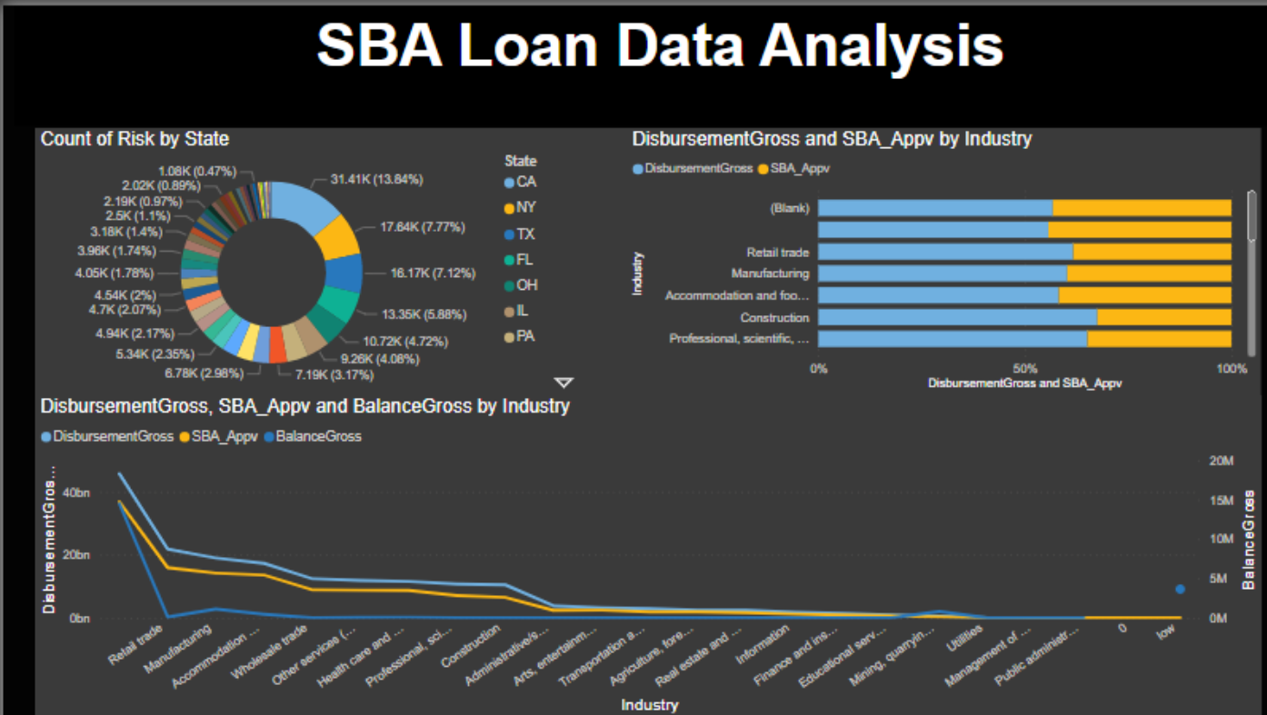
Dashboard displays analytics for faster decision making
View business location, type, and risk factors in a graphic interface
Notes:
Dashboard / user interface
Here’s a sample dashboard for the Risk Classificato

Slide 9
Expedite SBA loan processing in a few weeks
Kick-off
Proof of value
Proof of concept
Learn more about the Risk Classification and Loan Modeling Solution Accelerator and view a demo.
Solution code walk-through and prototype creation for testing.
Proof of concept (PoC) is built and deployed with support of the technical specialists and partners.
30 minutes
1-3 days
2-5 weeks
Notes:
Call To Action – next steps
The journey to proof of concept takes only a few weeks, including creation of a prototype tailored to your needs.
[Field Note: At this point, we transition from the business value discussion to a more technical portion of the deck. You may continue to walk through it with a TDM at this point or at a later date, as needed. ]]

Slide 10
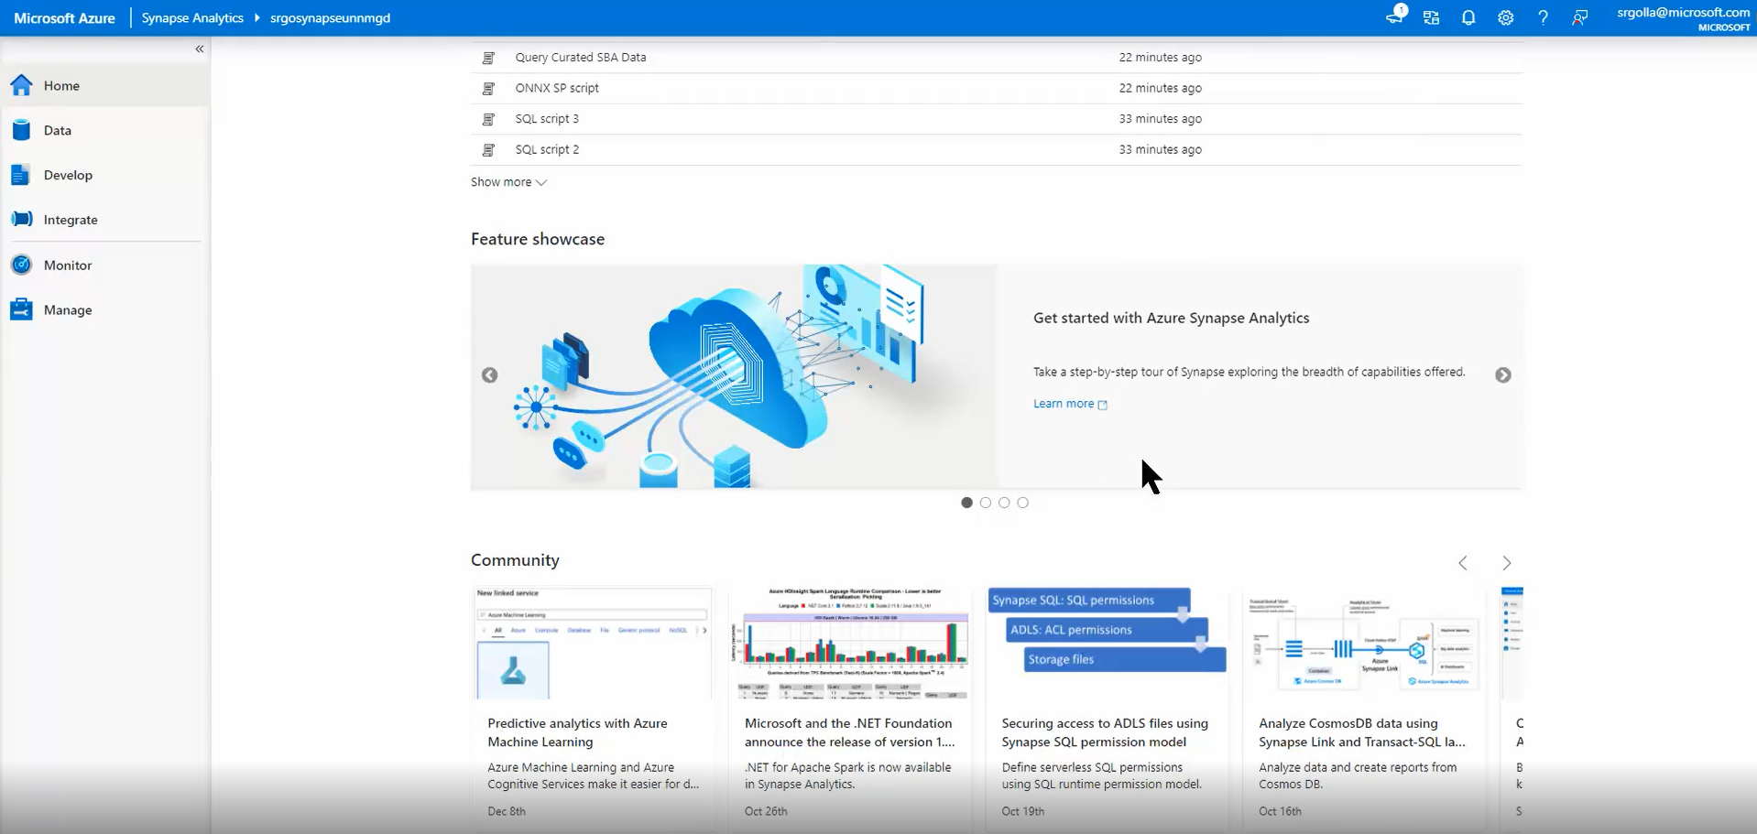
View instructional demos and documents
View video demos here
For detailed instructions, read the lab guide here.
Notes:
Demo

Slide 11
Expedite SBA loan processing with machine learning
Risk Classification and Loan Modeling Solution Accelerator enables fast, accurate evaluation
Automate loan application data ingestion, compliance criteria from the SBA, storage, data cleansing and enrichment.
Apply massively parallel processing (MPP) and high-performance analytics to petabytes of data at scale.
Optimize machine learning model with AutoML, using fewer resources and accelerating time to machine learning.
Quickly provide accurate analytics and insights for data-driven business decisions.
Reduce deployment time with pre-configured solution.
Notes:
Technical Value
Simplicity of execution means you can no need to code an integration. No bespoke applications needed. ​
Removes need for legacy, manual, error-prone systems
Operational support – one team to manage the entire event. Makes technical users life a lot easier. ​
Scale – you can quickly manage and process multiple loan applications at a time, and expedite decisions, so that you don’t have to keep applicants waiting
Field note
Automated ML or AutoML: Automated machine learning, also referred to as automated ML or AutoML, is the process of automating the time-consuming, iterative tasks of machine learning model development. It allows data scientists, analysts, and developers to build ML models with high scale, efficiency, and productivity all while sustaining model quality. Traditional machine learning model development is resource-intensive, requiring significant domain knowledge and time to produce and compare dozens of models. With automated machine learning, you'll accelerate the time it takes to get production-ready ML models with great ease and efficiency.
For more on AutoML: https://docs.microsoft.com/en-us/azure/machine-learning/concept-automated-ml

Slide 12
Drive faster, more accurate SBA loan approvals and rejections
Predictive modeling and machine learning power insights for data-driven decision making
Orchestration
Data storage and processing
Machine Learning
Visualization
Synapse Pipeline ingests and transforms data to meet requirements for ML model.
Data is stored in Azure Data Lake and cleansed, enriched, and analyzed in Azure Synapse.
Azure Machine Learning runs AutoML enhanced model to predict optimal loan amount for SBA approval.
View analytics for one or multiple applicants in SQL, Power BI, or custom application dashboards.
Notes:
The Risk Classification and Loan Modeling Solution Accelerator combines the power of Automated Machine Learning (AutoML) with rich data integration and processing, and dashboards in SQL, Power BI, or other dashboard applications.
​
Synapse Pipeline ingests and transforms data to meet requirements for your ML model, including requirements for the various types of Small Business Administration loans​
Azure Data Lake stores the data; Azure Synapse cleanses, enriches, and analyzes the data.
Azure Machine Learning and Azure Automated Machine Learning work together to accurately predict whether the applicant is approved for an SBA loan, and if so, for how much
SQL and Power BI provide dashboards of historic, geographic, industry, and risk factors for one or multiple applicants. Dashboards can be rendered in a custom web or mobile application, as well.
​
Field note: Here is a breakdown of the built-in Azure services in detail:​
Azure Data Lake​
Scalable data storage and analytics service​
​
Azure Synapse​
Analytics service for large volumes of data that enables querying and analysis​
Azure Synapse Pipeline​
A tool for grouping activities and data that together perform a task (Pipelines and activities - Azure Data Factory & Azure Synapse | Microsoft Docs)
Azure Machine Learning
A cloud service for accelerating and managing the machine learning project lifecycle.
Azure Automated Machine Learning (AutoML)
The process of automating the time-consuming tasks of machine learning model development
​​
Azure SQL Server​
Managed cloud database​
​​
Power BI​
Interactive data visualization software focused on business intelligence

Slide 13
Dashboard displays analytics for faster decision making
View business location, type, and risk factors in a graphic interface
Notes:
Dashboard / user interface

Slide 14
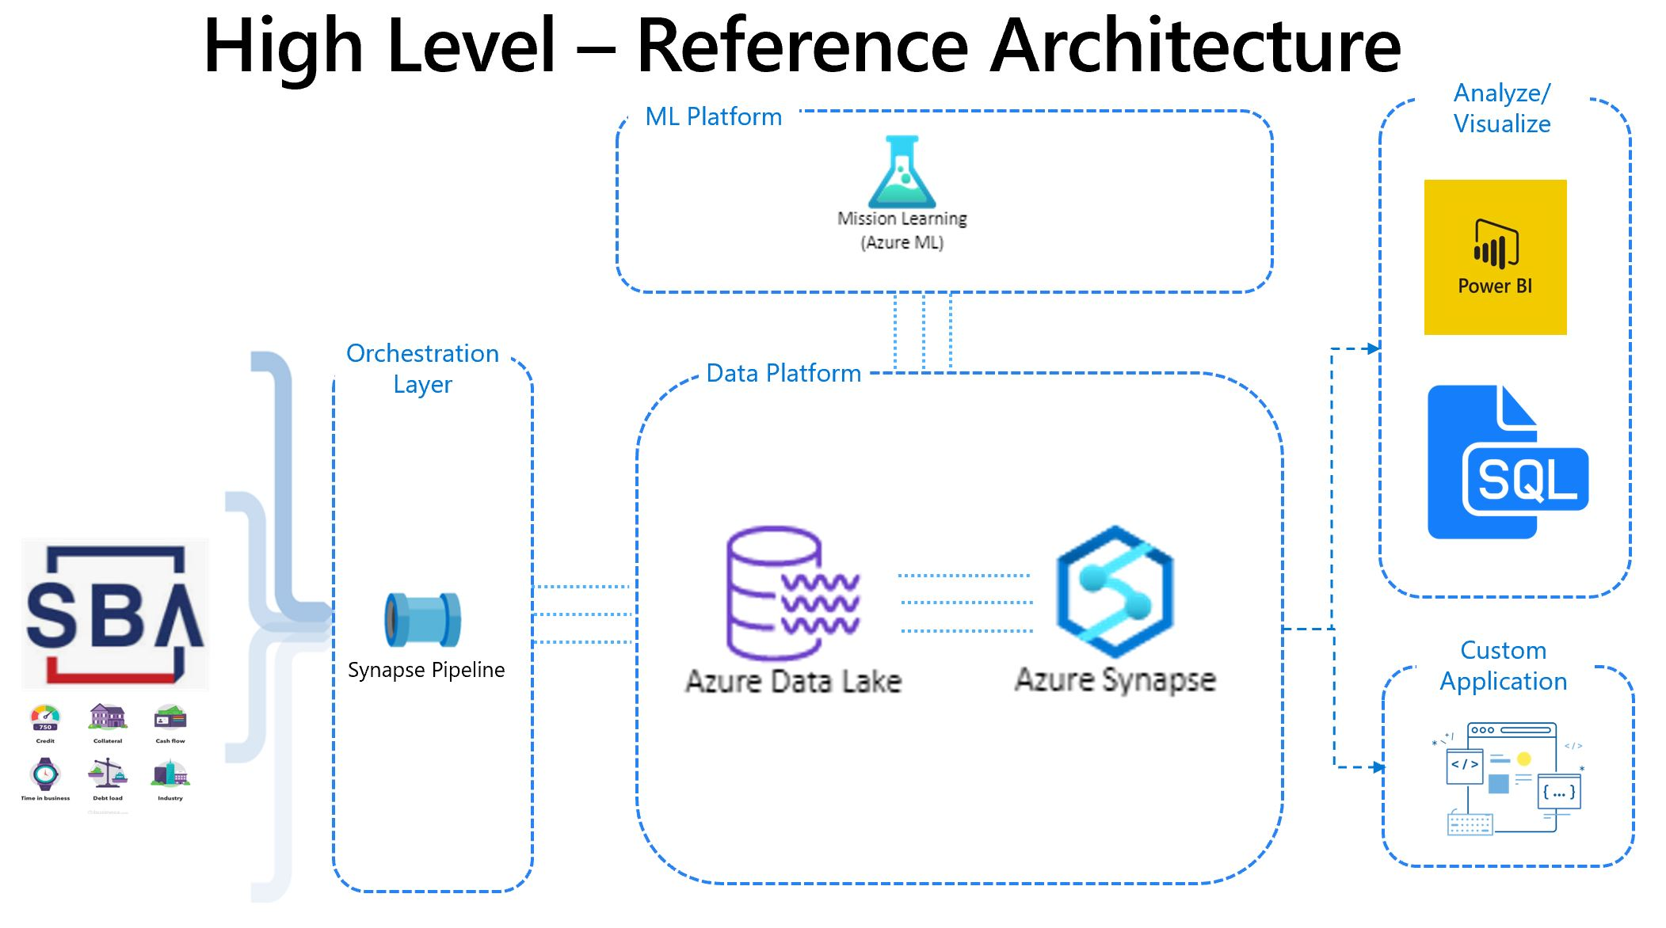




Reference architecture
Inputs from the SBA and applicant criteria are integrated quickly and easily
ML Platform
Analyze/ Visualize
Mission Learning (Azure ML)
Orchestration Layer
Data Platform
Custom Application
Synapse Pipeline
Azure Data Lake
Azure Synapse
Notes:
Reference architecture
This solution’s architecture can accommodate massive amounts (PBs) of data ingestion
Orchestration Layer: Define Synapse Pipeline as well as data source and target for each step of the process to run automatically, on a schedule, or to be triggered manually
Data Platform: Loan application data is stored in Azure Data Lake. Azure Synapse MPP’s high performance analytics and parallel processing engine processes, cleanses, enriches, and curates the data.
ML Platform: Azure Machine Learning’s Auto ML optimizes machine learning model, removing the burden of iterative modeling and analytics from data scientists. It generates ML model that can pull from application data in real time and predict how much borrower will be approved for
Analyze/ visualize: view analytics and ML predictions for one or multiple loan applications in dashboards and graphic interfaces for better, data-driven SBA loan-making decisions.

Slide 15
Take the next step to fast, easy SBA loan assessments
Deploy resources
Prepare data
Train model
Create a resource group you can use as a container to begin deploying PaaS resources to Azure.
Build your data pipeline and implement data cleansing, transformation, enriching, and governance using PaaS services.
Use AutoML to determine the best ML model for your underlying data and train your optimized ML model to improve prediction accuracy.
With demo data create a POV in 1-3 days.
With your customer data and a prep session, create your POC in 2-5 weeks.
Notes:
Steps to MVP deployment
One of the ways we demonstrate our commitment to your experience working with Microsoft is to provide guidance at each step of the deployment process. Now that you’ve seen the demo, we can go into GitHub together and customize the model with your data. Once the MVP has been created, we will help you scale your deployment!
GitHub link: https://github.com/ketsha/Business-Loan-Modeling

Slide 16
Thank you

Slide 17



Additional use cases
The Risk Classification and Loan Modeling Solution Accelerator has a range of applications
Portfolio management
Evaluate, predict, and manage portfolio health.
Digital advisor
Manage and automate customer trading strategies with predictive modeling.
Financial crime detection
Use predictive analytics to detect fraud, prevent money laundering, and more.
Customer screening
Vet customers for financial liability and regulatory compliance.
Notes:
Additional use cases

